Slide 1
History of SQL
SQL was originally known as SEQUEL, which stands for Structured English Query Language. ​
SEQUEL was developed by D. Chamberlin and F. Boyce at IBM in the 1970s and first version is released in 1979.​
SEQUEL was later renamed as SQL(Structured Query Language.) in year 1981 by the person E. F. Codd.​
Today​
Maintained by Oracle​

Slide 2
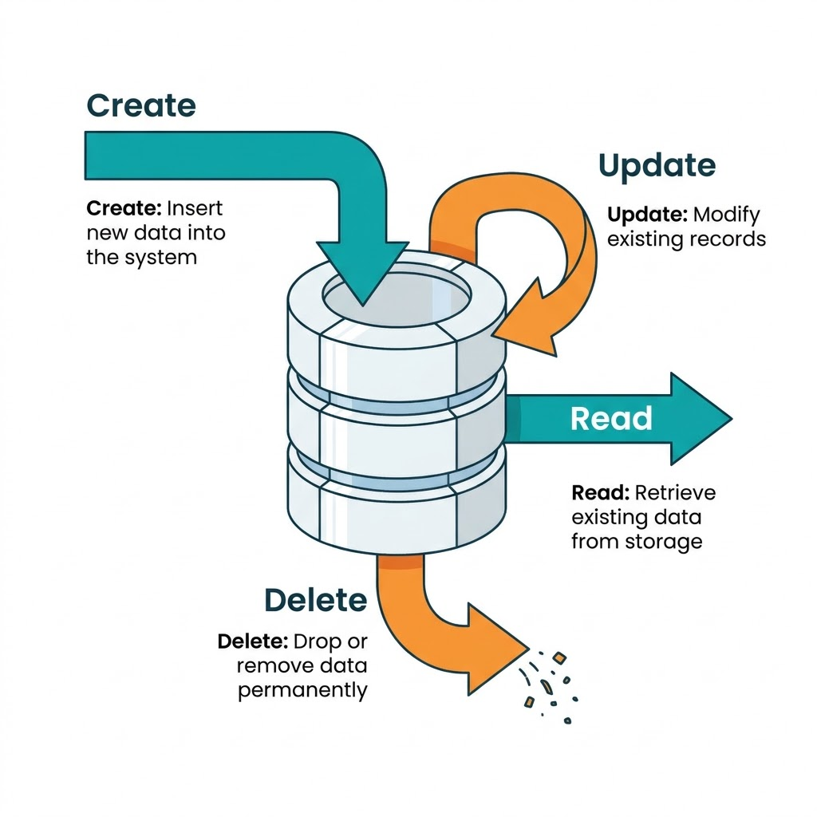
SQL :
Backend technology to communicate with software known as RDBMS (Relational Database Management System)
Database :
Database it is place in which we store a data or
information in systematic and organized manner.
On database we perform four operations called
CRUD operation.

Slide 3
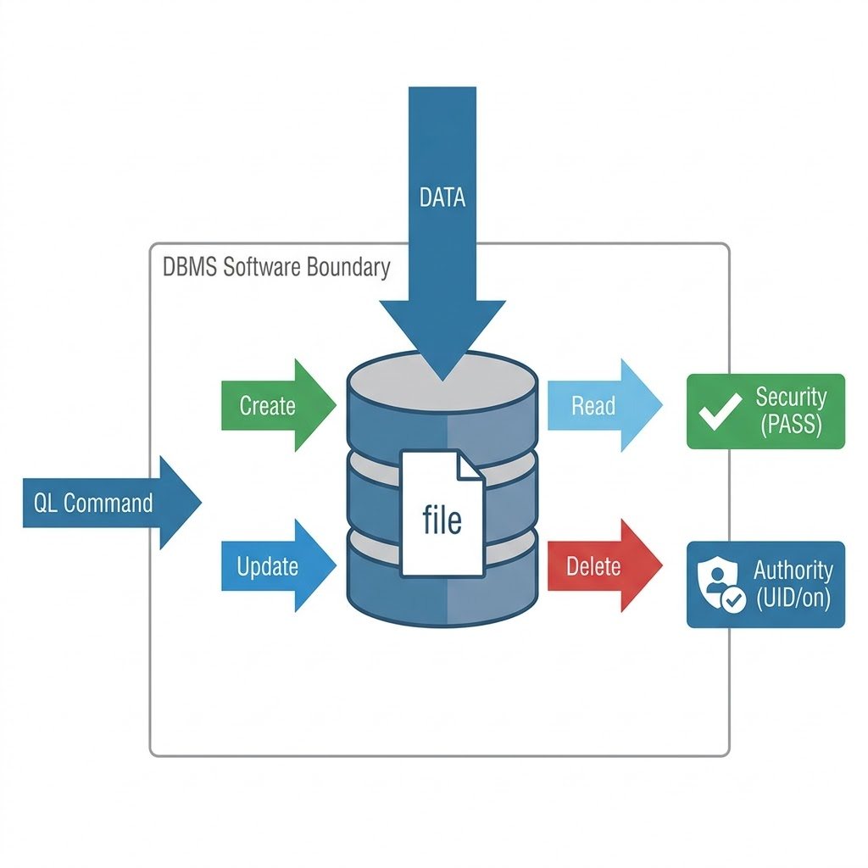
DBMS :
DBMS is a software which is used to maintain and managed the database.
Externally it will store data in form of file format but internally it will store in the form of table and json form.
To interact with DBMS software we uses query language .
Types:
1.Relational DataBase Management System
2.Non-Relational DataBase Management System

Slide 4
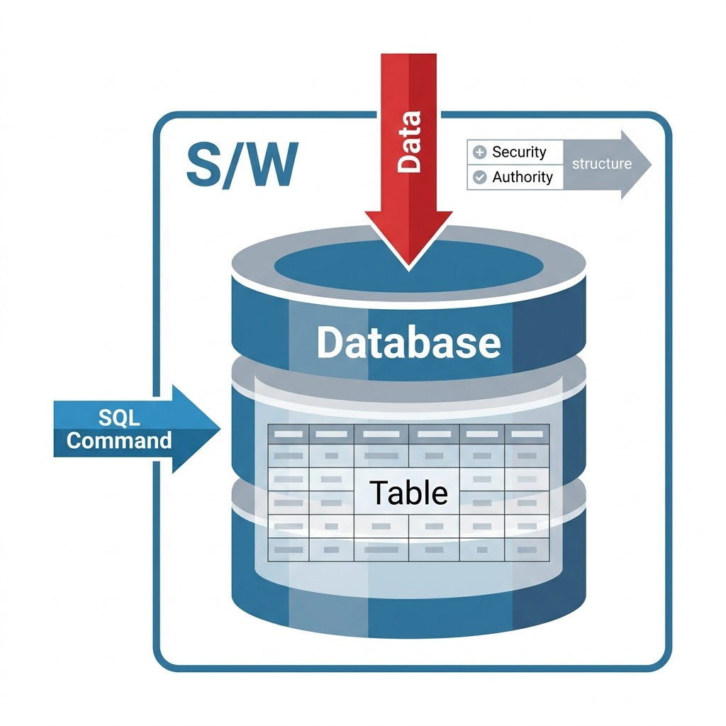
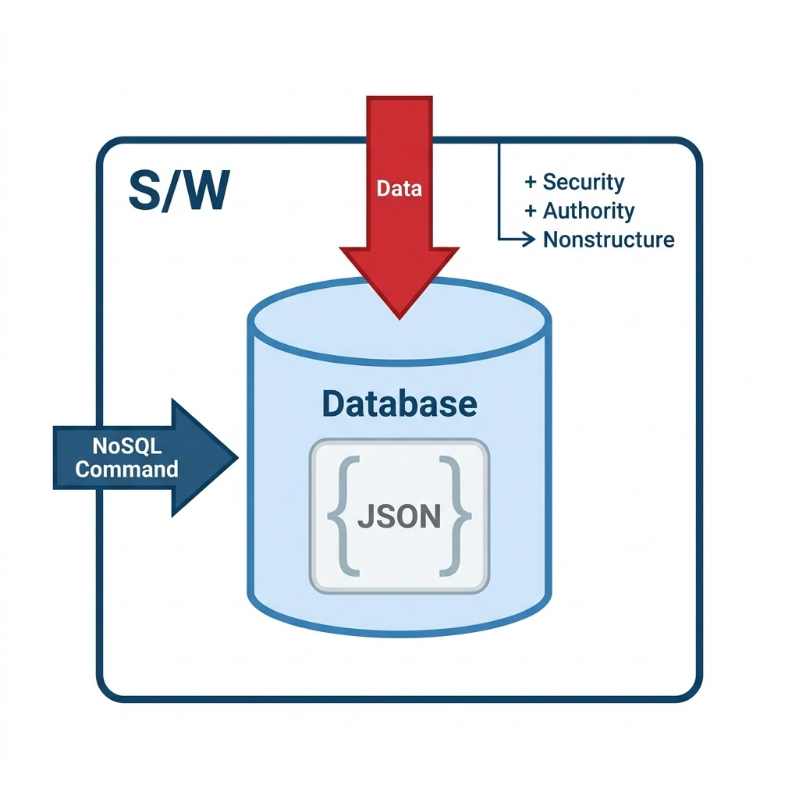
RDBMS And NRDBMS:
It is a types of DBMS which is used to store data .
RDBMS NRDBMS

Slide 5
Differenciate :
RDBMS | NRDBMS
Easy to maintain the data due to table format organization | Difficult to maintain the data due to json format organization
It is suitable for text data | It is suitable for multi-media data
RDBMS will not support for nested concept.it supports relations. | It supports nested concept (file inside file)
Schema Validation is mandatory | Schema validation is optional
It supports only vertical scaling | It supports both horizontal and vertical scaling
RDBMS will support complex queries(joint,subqueries) | It won't support complex queries
Mysql, Oracle SQL , Postgrey SQL | MangoDB, AmazonDB ,Django

Slide 6
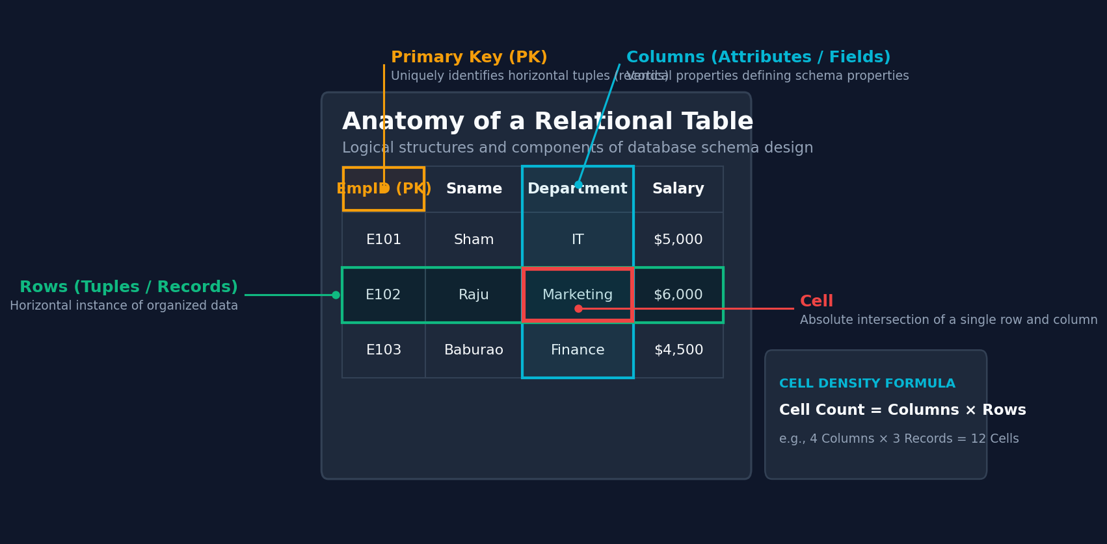
Table :
Logical arrangement of rows and column are called table .

Slide 7
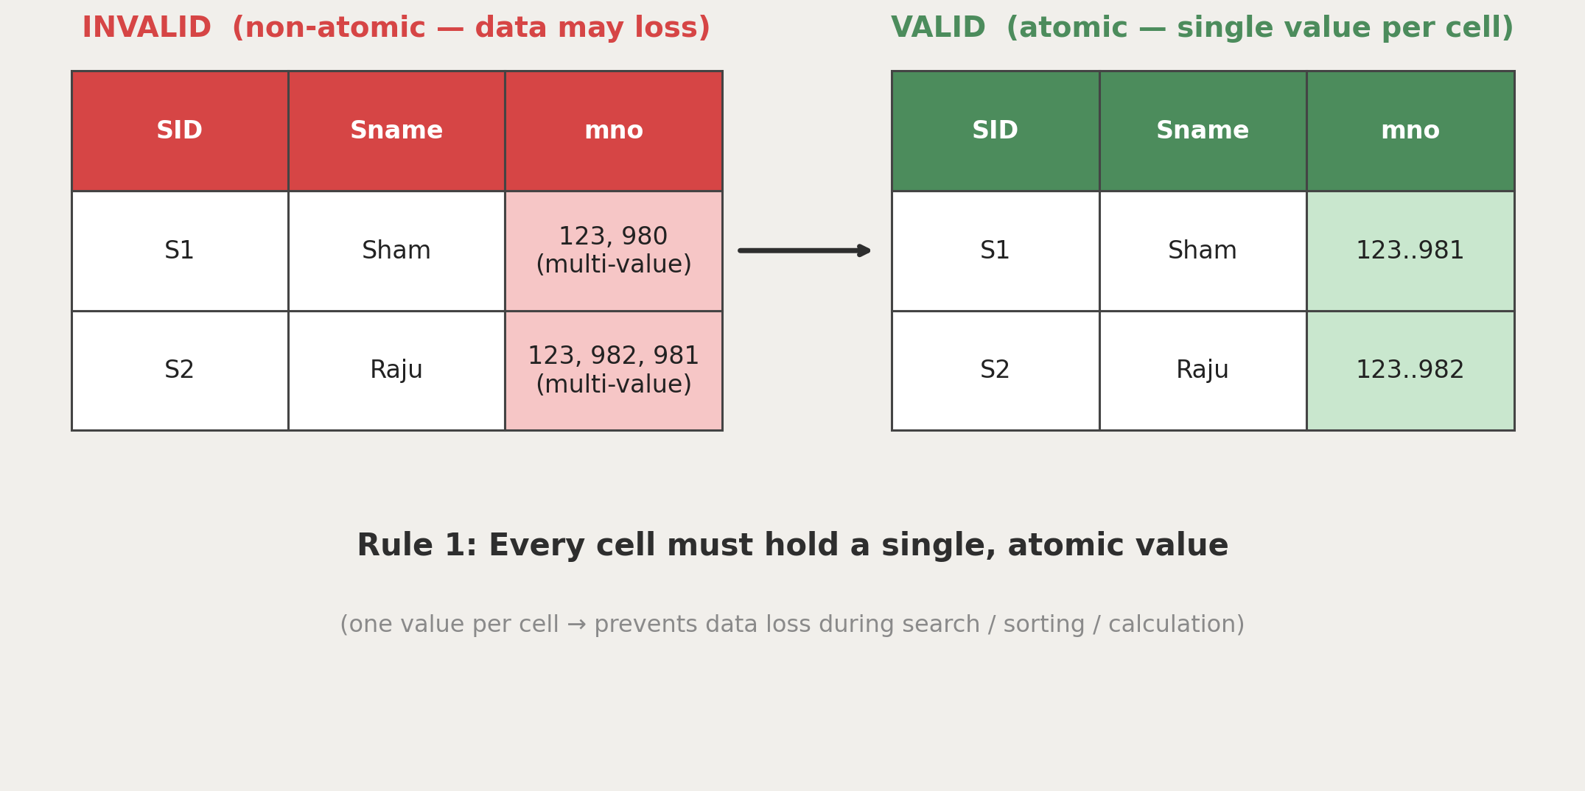
Rules of Table : Rule 1 — Atomic Data

Slide 8
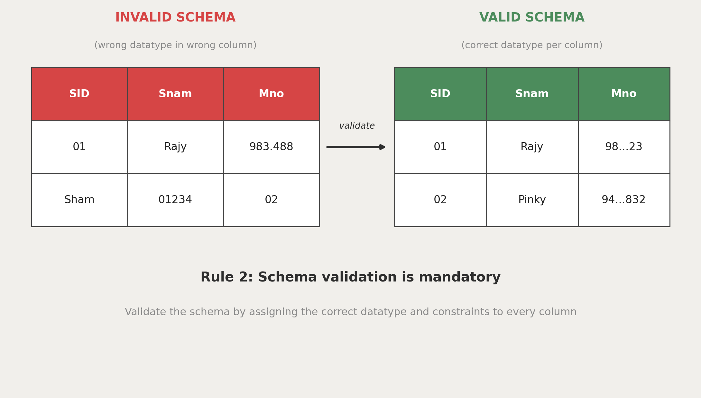
Rules of Table : Rule 2 — Schema Validation

Slide 9
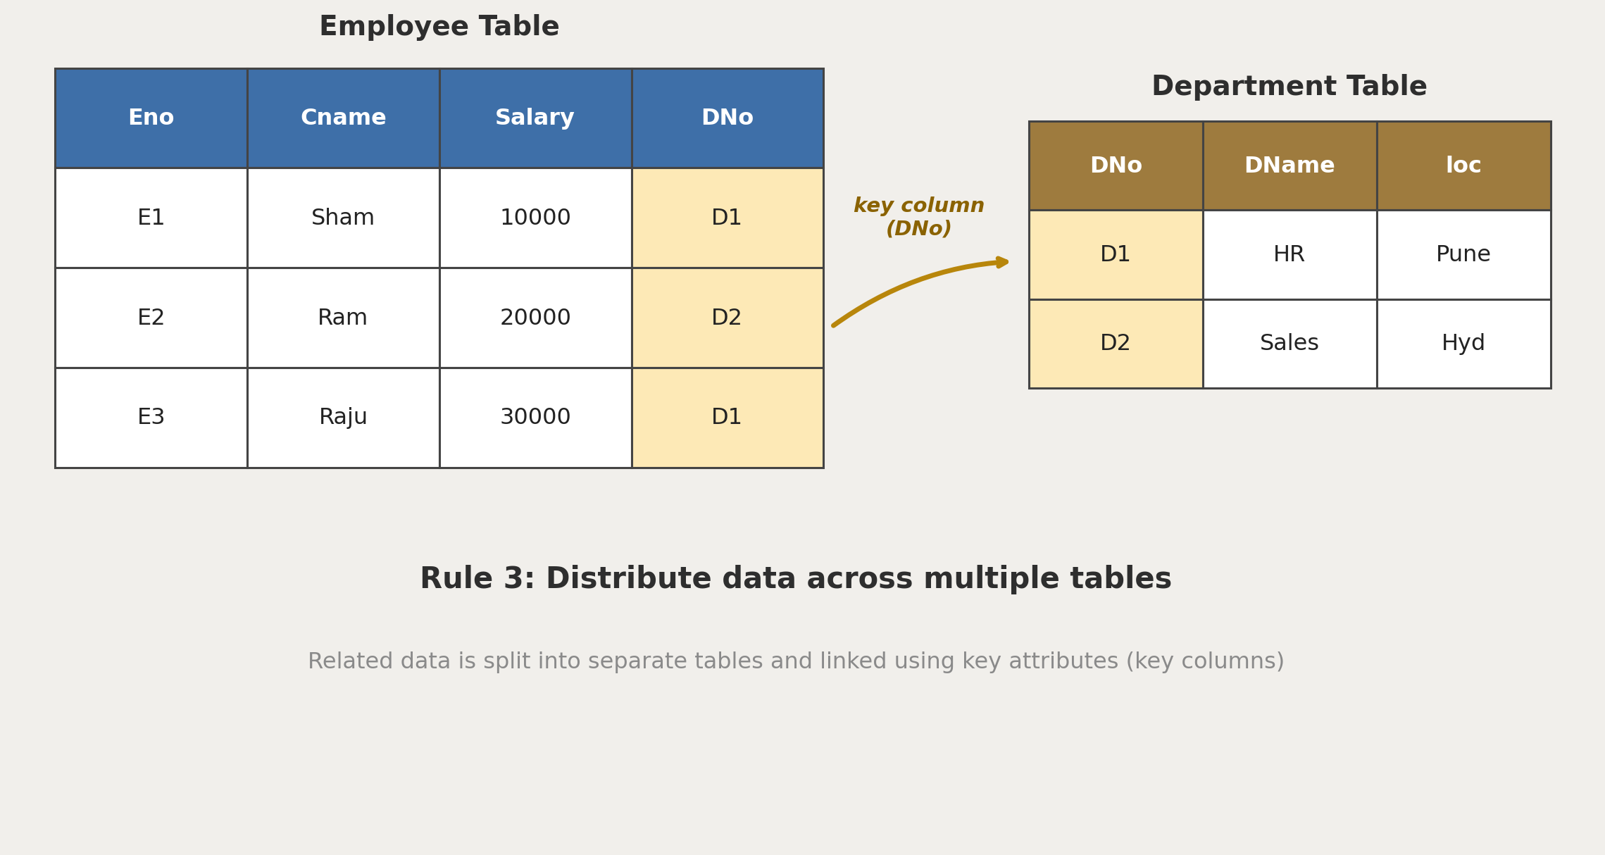
Rules of Table : Rule 3 — Key Attributes

Slide 10
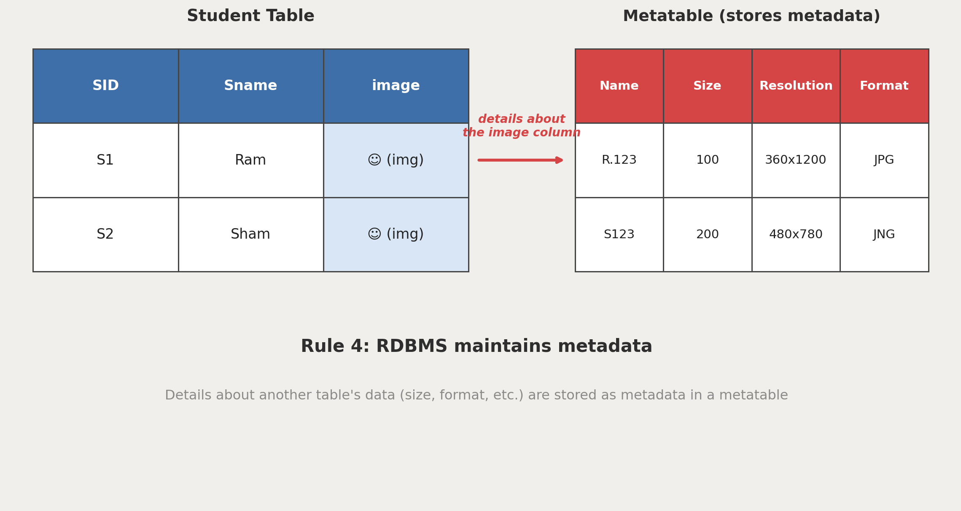
Rules of Table : Rule 4 — Metadata

Slide 11
Schema Validation :
It is the process of validating or verifying whether the proper data is getting stored in the respective column or not.
The schema validation we can do by assigning two things to the column:
By assigning datatype to the column.
By assigning constraints to the column.

Slide 12
Datatypes :
Datatypes are used to determine which kind of data should get stored into perticular memory location.
In SQL, mainly there are five datatypes:-
char()
Varchar() / varchar2()
DATE()
Number()
Large Object:
i) Character large object()
ii) Binary large object()

Slide 13
1) Char datatype : (fixed type data)
Syntax:- char (size)
provide block required to store (up to 2000)
Eg: char(10)
The char datatype will follow fixed length of memory allocation. (drawback)
char(10)
[ S | M | I | T | H | | | | | ]
S M I T H used memory
Remaining 5 blocks unused memory / waste memory

Slide 14
2)Varchar / Varchar 2 datatype : (variable size data)
Varchar :
Syntax :- Varchar (size) maximum (2000) size
Eg:- Varchar (10)
[ 1 | 2 | 3 | 4 | 5 | 6 | 7 | 8 | 9 | 10 ]
The varchar datatype will follow variable length of memory allocation.
[ S | M | I | T | H ] | [ | | | | ]
S M I T H used memory and unused memory will get subtracted and added to original memory, no wastage of memory in it.

Slide 15
Varchar2() :
Syntax : Varchar2(size) maximum (4000) size
Varchar 2 is a updated version of Varchar datatype which specifically make for variable size of string data.
3) Large Object :
This datatype is used to store the large amount of data in the column. The large object has been classified into two types :-
1) Character Large Object :
This data type is used to store the huge amount of string data upto 4GB.
Syntax : CLOB ()

Slide 16
2) Binary Large Object :-
This data type is used to store an any multimedia type of data & maximum limit is 4GB.
Syntax : BLOB (multimedia)
1GB = 1.074{ Million character}
4) DATE() :
This data type is used to store an any date kind of information.
Syntax : DATE()
In SQL, there are two format to stores the data.
'DD-MON-YY' OR 'DD-MON-YYYY'

Slide 17
5) Number datatype :
This datatype is used to store any numeric type of data.
Syntax :-Number (Precision, [Scale]) (Scale is optional)
Precision : It is used to determine the number of digits which are required to store an any integer value.
The range of the precision is 1 to 38.
The precision value cannot be 'zero' & negative.
The default value for the precision is 38.

Slide 18
Scale :
Scale is an optional argument which is used to determine thenumber of digit which are used to store an any decimal part within thegiven precision.
The range of scale is -84 to +127.
The default value for the scale is zero.
It is a optional argument.

Slide 19
Constraints :
Constraints are the rules which are used to validate the schema by assigning any particular condition.In SQL, there are 7 types of constraints:
1) Unique Constraint : used to remove repeated values from any column.
Syntax : unique
2) Null : a constraint used to consider a respective column as an optional column.
Syntax : Null
3) Not Null : a constraint used to consider a respective column as a mandatory column.
Syntax : Not null

Slide 20
4) Check : a constraint used to assign a condition on the column.
Syntax : check(condition)
If condition is True → value = 1 (valid); If False → value = 0 (invalid)
Eg : check(salary > 0) , check(length(mno) = 10)
5) Autoincrement : used to assign an autoincrement feature to any column.
Syntax : Autoincrement(start-point, skip value, end value)
6) Default : used to assign any default value for a column.
Syntax : Default value
Eg : Default 'ICS'

Slide 21
7) Primary Key :
Primary key is a constraint used to identify any unique record in the table.
Syntax : primary key
The primary key is a combination of the Unique and Not Null constraints.
It will not allow any repeated value and also will not allow an empty set.
In one table we can have only one primary key.
The primary key of one table can become the foreign key in another table.
We can also make multiple columns together act as one primary key — this kind of column combination is known as a Composite Key.

Slide 22
Foreign Key :
Foreign key is used to establish a connection between multiple tables.
Syntax : foreign key(column name) References parent-table-name(col-name)
The foreign key is not a Not Null constraint — a foreign key column will allow an empty set.
The foreign key will allow repeated values of the referenced unique key.
In one table we can have multiple foreign keys.
The foreign key will be present in the child table.
The moment we add a foreign key, a relation gets established between the tables. This is also known as Referential Integrity constraint.
The relation always shows from the parent table to the child table.

Slide 23
Types of Relationships :
In SQL, there are four types of relations:
1) One to One : one record from the parent table refers to only one record in the child table. Eg : User → Passport
2) One to Many : one record from the parent table refers to many records in the child table. Eg : Department (1) → Employee (m)
3) Many to One : multiple records refer to only one record in the parent table. Eg : Student (m) → Department (1)
4) Many to Many : multiple records from one table refer to multiple records of another table. Eg : Actors ↔ Movies
To maintain a many-to-one or many-to-many relation, we need to create one more table called a Junction Table to handle the relations.

